Slide 1
Fresnel & Fraunhofer Diffraction

Slide 2
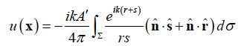
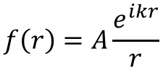
The Theory:
Huygens’s Principle:
Every point on a wave-front may be considered a source of secondary spherical wavelets which spread out in the forward direction at the speed of light. The new wave-front is the tangential surface to all of these secondary wavelets.
Christian Huygens, 1670
The blocked secondary wavelets (by the aperture)
$$f\left(r\right)=A\frac{e^{ikr}}{r}$$
The point source (spherical wave)
Use Fresnel-Kirchhoff’s equation:
On the screen: the superposition of the passed wavelets.
The passed secondary wavelets (by the aperture)

Slide 3
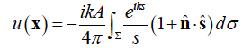
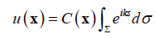
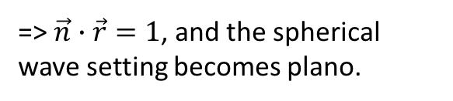
Assumptions in this project:
The aperture is flat. Thus we only have to integrate on a fixed-z plane.
The point source P is at infinity so that we have incident plane waves. We further assume that we have normal incident plane waves.
=> $\vec{n}∙\vec{r}=1$, and the spherical wave setting becomes plano.
One more step: the Fraunhofer’s approximation, (With large distance between the aperture to the screen.)

Slide 4
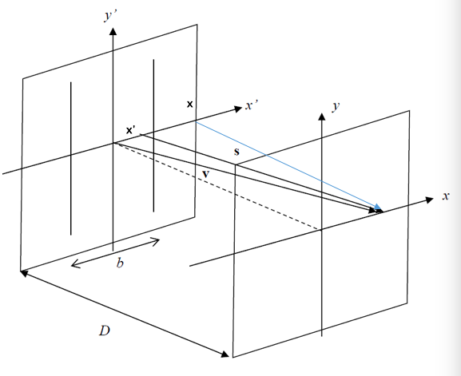
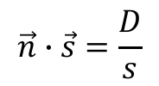
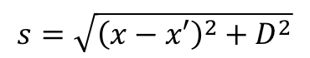
Results:
1D aperture
From the geometric relations:
$$\vec{n}∙\vec{s}=\frac{D}{s}$$
Draw a normal vector intersecting x’-y’ plane at x.
$$s=\sqrt{{\left(x−x′\right)}^{2}+D^{2}}$$
Insert these two equations into the diffraction equation:
n
(Next page)

Slide 5
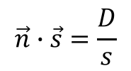
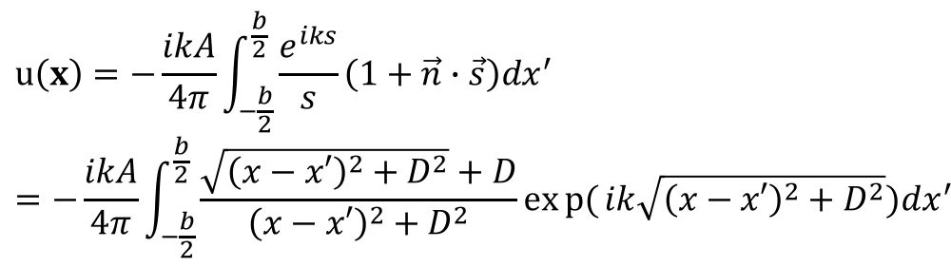
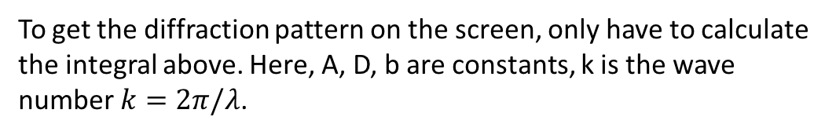
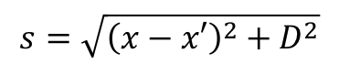
$$\vec{n}∙\vec{s}=\frac{D}{s}$$
$$s=\sqrt{{\left(x−x′\right)}^{2}+D^{2}}$$
$$u\left(x\right)=−\frac{ikA}{4π}\int_{−\frac{b}{2}}^{\frac{b}{2}}{\frac{e^{iks}}{s}\left(1+\vec{n}∙\vec{s}\right)dx^{′}}=−\frac{ikA}{4π}\int_{−\frac{b}{2}}^{\frac{b}{2}}{\frac{\sqrt{{\left(x−x′\right)}^{2}+D^{2}}+D}{{\left(x−x′\right)}^{2}+D^{2}}exp{(}ik\sqrt{{\left(x−x′\right)}^{2}+D^{2}})dx^{′}}$$
To get the diffraction pattern on the screen, only have to calculate the integral above. Here, A, D, b are constants, k is the wave number $k=2π/λ$.

Slide 6
Use Gaussian quadrature to calculate the integral,
x,w = gaussxwab(N,-0.5,0.5)
s = 0+0j
D = 5
for k in range(N):
re1,re2 = f(x[k],D)
s += w[k]*(re1+1j*re2)
def f(xp,D):
theta = arange(0,pi/2,0.01)
x = D*tan(theta)
re1 = real((sqrt((x-xp)**2/D**2+1)+1)/((x-xp)**2/D**2+1)*exp(1j*2*pi/wavelength*sqrt((x-xp)**2+D**2)))
re2 = imag((sqrt((x-xp)**2/D**2+1)+1)/((x-xp)**2/D**2+1)*exp(1j*2*pi/wavelength*sqrt((x-xp)**2+D**2)))
return re1,re2

Slide 7
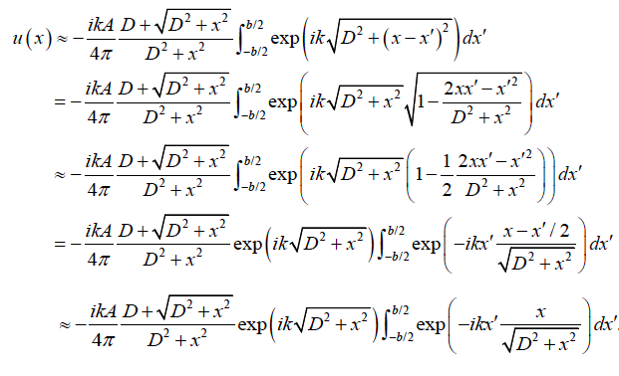
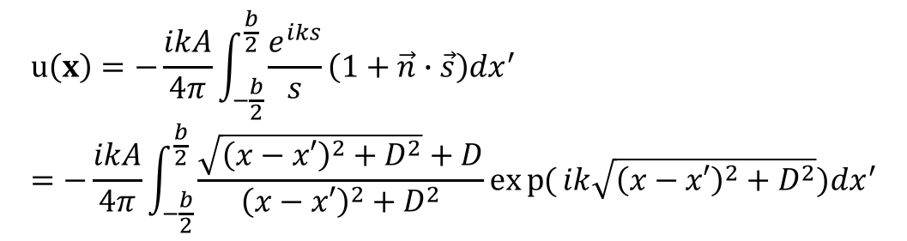
The Fraunhoher approximation: move the 1/r out of the integral
$$u\left(x\right)=−\frac{ikA}{4π}\int_{−\frac{b}{2}}^{\frac{b}{2}}{\frac{e^{iks}}{s}\left(1+\vec{n}∙\vec{s}\right)dx^{′}}=−\frac{ikA}{4π}\int_{−\frac{b}{2}}^{\frac{b}{2}}{\frac{\sqrt{{\left(x−x′\right)}^{2}+D^{2}}+D}{{\left(x−x′\right)}^{2}+D^{2}}exp{(}ik\sqrt{{\left(x−x′\right)}^{2}+D^{2}})dx^{′}}$$

Slide 8
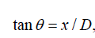
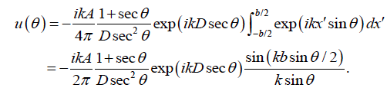
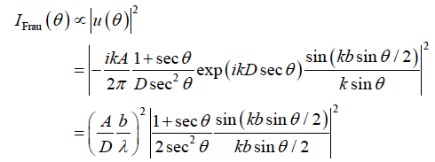
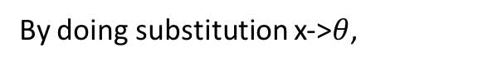
The Fraunhoher approximation
By doing substitution x->$θ$,

Slide 9
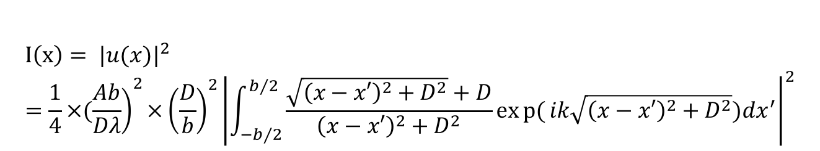
Calculate the diffraction pattern (the exact task of this project)
Fraunhoher:
Fresnel-Kirchhoff:
$$I\left(x\right)= {|u(x)|}^{2}=\frac{1}{4}×({\left.\frac{Ab}{Dλ}\right)}^{2}×{\left(\frac{D}{b}\right)}^{2}{\left|\int_{−b/2}^{b/2}{\frac{\sqrt{{\left(x−x′\right)}^{2}+D^{2}}+D}{{\left(x−x′\right)}^{2}+D^{2}}exp{(}ik\sqrt{{\left(x−x′\right)}^{2}+D^{2}})dx^{′}}\right|}^{2}$$

Slide 10
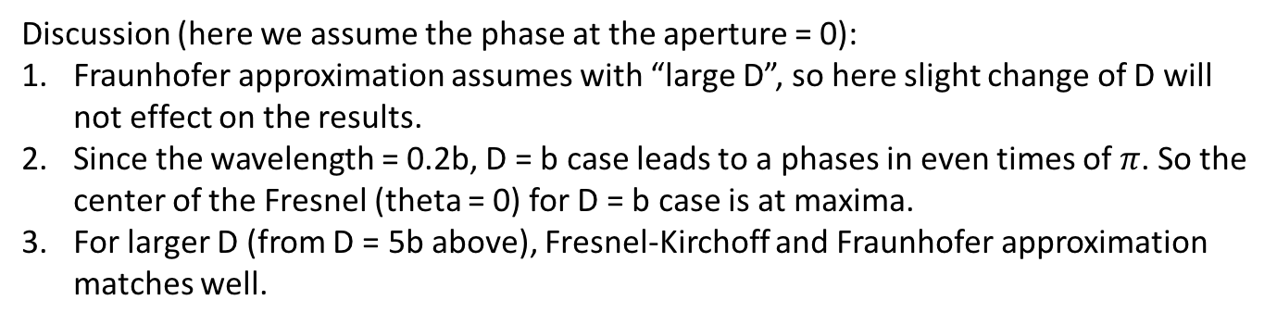
Result:
Discussion (here we assume the phase at the aperture = 0):
Fraunhofer approximation assumes with “large D”, so here slight change of D will not effect on the results.
Since the wavelength = 0.2b, D = b case leads to a phases in even times of $π$. So the center of the Fresnel (theta = 0) for D = b case is at maxima.
For larger D (from D = 5b above), Fresnel-Kirchoff and Fraunhofer approximation matches well.

Slide 11
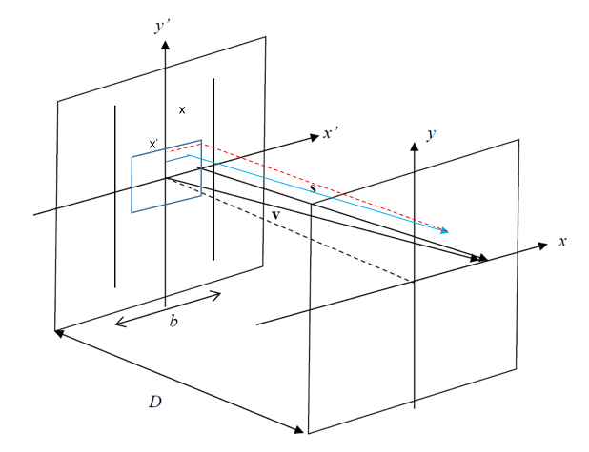
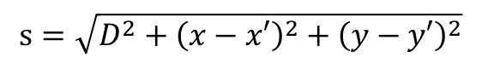
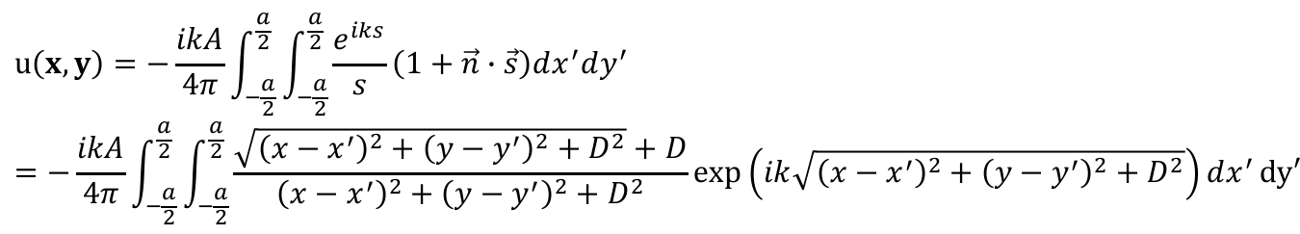
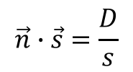
2D case: the rectangular aperture
Similarly, draw a normal vector (red dashed)
For an arbitrary wave vector s (blue solid), we have geometric relations:
$$s=\sqrt{D^{2}+{\left(x−x′\right)}^{2}+{\left(y−y′\right)}^{2}}$$
$$\vec{n}∙\vec{s}=\frac{D}{s}$$
$$u\left(x,y\right)=−\frac{ikA}{4π}\int_{−\frac{a}{2}}^{\frac{a}{2}}{\int_{−\frac{a}{2}}^{\frac{a}{2}}{\frac{e^{iks}}{s}\left(1+\vec{n}∙\vec{s}\right)dx^{′}dy^{′}}}=−\frac{ikA}{4π}\int_{−\frac{a}{2}}^{\frac{a}{2}}{\int_{−\frac{a}{2}}^{\frac{a}{2}}{\frac{\sqrt{{\left(x−x^{′}\right)}^{2}+{\left(y−y^{′}\right)}^{2}+D^{2}}+D}{{\left(x−x^{′}\right)}^{2}+{\left(y−y^{′}\right)}^{2}+D^{2}}\exp\left(ik\sqrt{{\left(x−x^{′}\right)}^{2}+{\left(y−y^{′}\right)}^{2}+D^{2}}\right)dx^{′}}}dy′$$

Slide 12
Use Gaussian quadrature to calculate the integral,
N = 100
point,w = gaussxwab(N,-a/2.,a/2.)
s = 0+0j
D = 0.5*a
x = 0
y = 0
length = len(arange(-1*a,1*a,0.02))
result = empty([length,length],complex)
for p in arange(-1*a,1*a,0.02):
for q in arange(-1*a,1*a,0.02):
for m in range(N):
for n in range(N):
re1,re2 = f(p,point[m],q,point[n],D)
s += w[m]*w[n]*(re1+1j*re2)
result[x,y] = s
y += 1
s = 0+0j
x += 1
y = 0
def f(x,xp,y,yp,D):
re1 = real(D/sqrt((x-xp)**2+(y-yp)**2+D**2)*(1+D/sqrt((x-xp)**2+(y-yp)**2+D**2))*exp(1j*2*pi/wavelength*sqrt((x-xp)**2+(y-yp)**2+D**2)))
re2 = imag(D/sqrt((x-xp)**2+(y-yp)**2+D**2)*(1+D/sqrt((x-xp)**2+(y-yp)**2+D**2))*exp(1j*2*pi/wavelength*sqrt((x-xp)**2+(y-yp)**2+D**2)))
return re1,re2

Slide 13
Result in log scale:
Fresnel:
Fraunhofer:
Matched with Fraunhoher: Large D

Slide 14
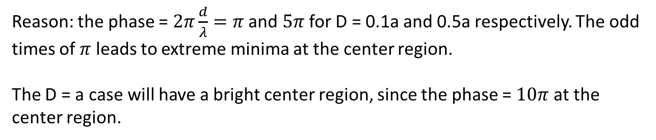
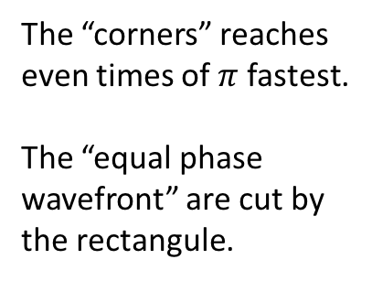
Discussion:
The wavelength: $λ=0.2a$ is fixed.
Thus, D = 0.1a and D = 0.5a cases, the center region of the screen should be at minima.
Reason: the phase = $2π\frac{d}{λ}=π$ and $5π$ for D = 0.1a and 0.5a respectively. The odd times of $π$ leads to extreme minima at the center region.
The D = a case will have a bright center region, since the phase = $10π$ at the center region.
What if the aperture is rectangular?
The “corners” reaches even times of $π$ fastest.
The “equal phase wavefront” are cut by the rectangule.
Pic from wiki

Slide 15
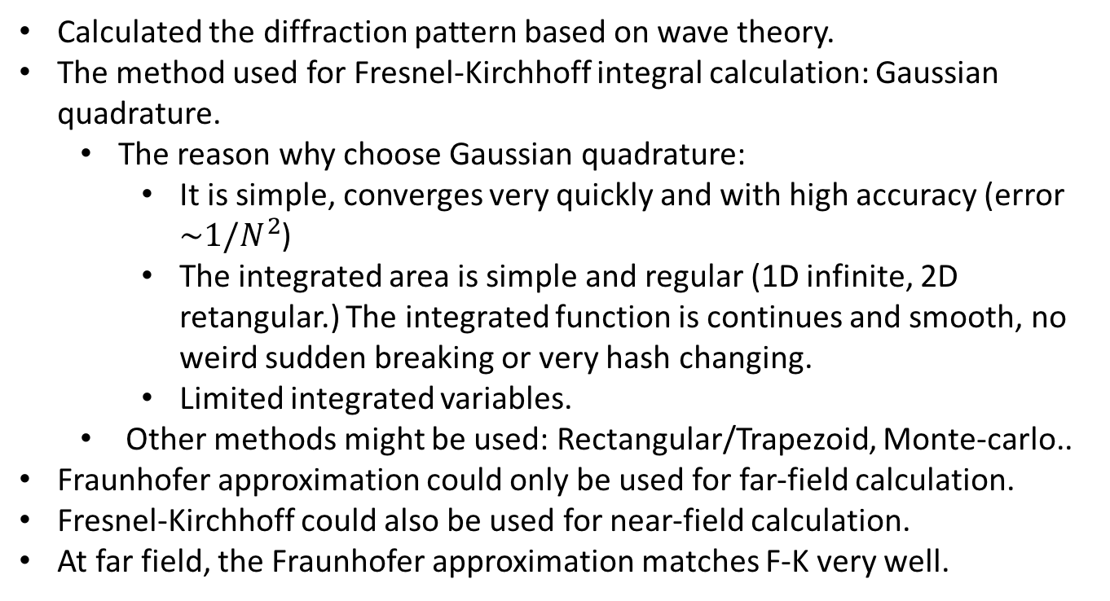
Summary
Calculated the diffraction pattern based on wave theory.
The method used for Fresnel-Kirchhoff integral calculation: Gaussian quadrature.
The reason why choose Gaussian quadrature:
It is simple, converges very quickly and with high accuracy (error $\sim 1/N^{2}$)
The integrated area is simple and regular (1D infinite, 2D retangular.) The integrated function is continues and smooth, no weird sudden breaking or very hash changing.
Limited integrated variables.
Other methods might be used: Rectangular/Trapezoid, Monte-carlo..
Fraunhofer approximation could only be used for far-field calculation.
Fresnel-Kirchhoff could also be used for near-field calculation.
At far field, the Fraunhofer approximation matches F-K very well.

